Slide 1
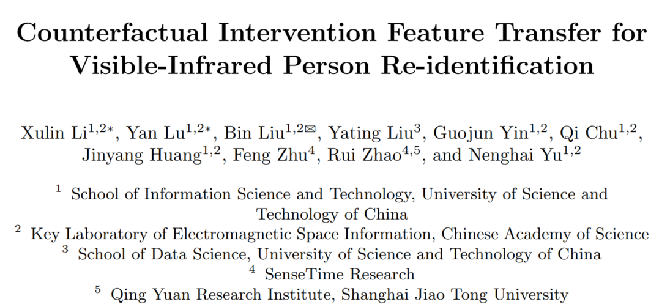



Slide 2
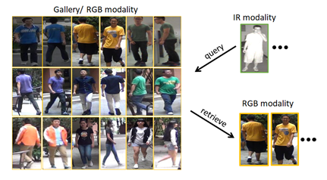
Background
Visible-infrared person re-identification (VI-ReID) aims to match pedestrian images of the same identity captured by different modality cameras.

Slide 3

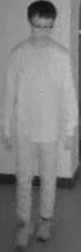


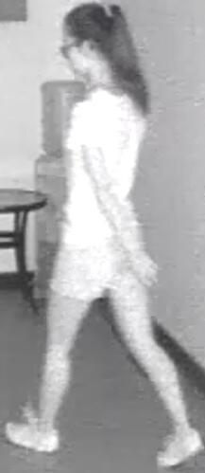
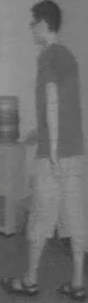

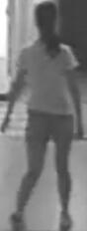
Background
Graph-based methods have achieved excellent performance in VI-ReID task, because they can spread information between different modality data.
Graph Model
message passing

Slide 4
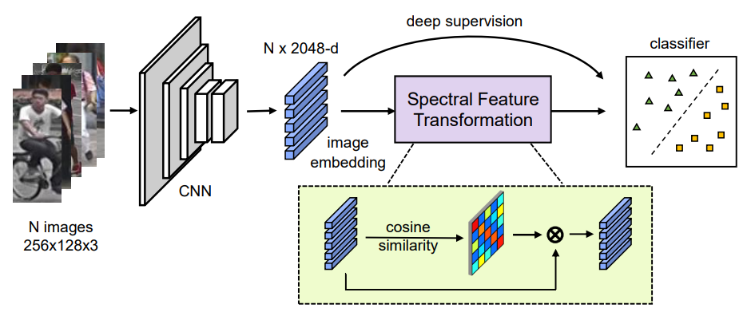
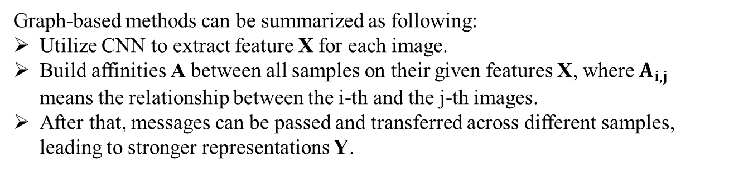
Background
Graph-based methods can be summarized as following:
Utilize CNN to extract feature X for each image.
Build affinities A between all samples on their given features X, where $A_{i,j}$ means the relationship between the i-th and the j-th images.
After that, messages can be passed and transferred across different samples, leading to stronger representations Y.
X
A
Y
Luo C, Chen Y, Wang N, et al. Spectral feature transformation for person re-identification[C]//Proceedings of the IEEE/CVF international conference on computer vision. 2019: 4976-4985.

Slide 5
Existing Problem
However, we find existing graph-based methods in the VI-ReID task suffer from bad generalization because of two issues:
Train-test modality balance gap
Sub-optimal topology structure
Notes:
一

Slide 6
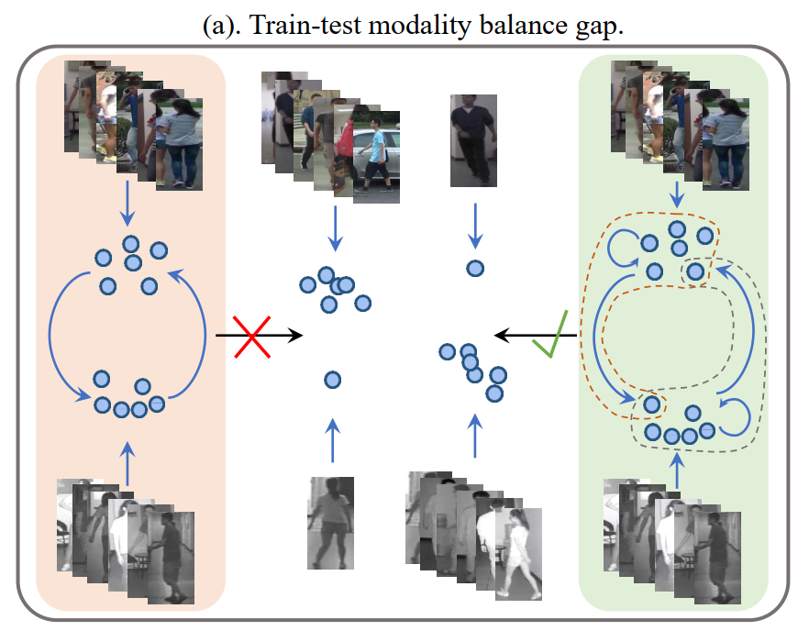
Train-test modality balance gap
Train-test modality balance gap, which is a property of VI-ReID task. The number of two modalities data are balanced in the training stage but extremely unbalanced in inference.
Our method overcomes this problem by unbalanced scenarios simulation and a novel graph module design.
Notes:
The red background hints at the existing methods and the green one means our method.

Slide 7
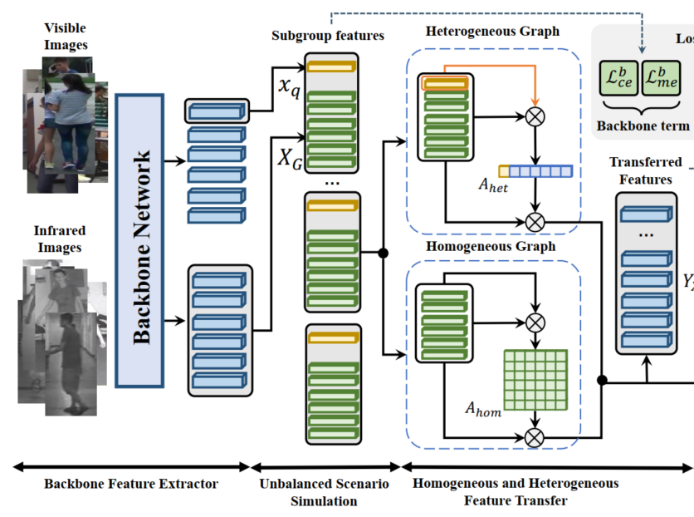
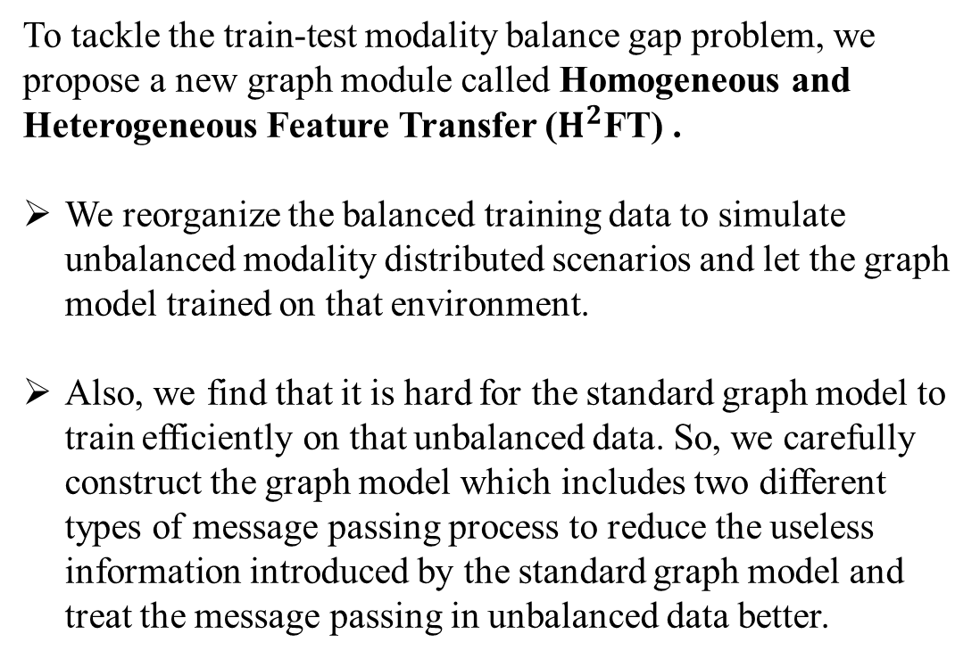
Homogeneous and Heterogeneous Feature Transfer
To tackle the train-test modality balance gap problem, we propose a new graph module called Homogeneous and Heterogeneous Feature Transfer ($H^{2}$FT) .
We reorganize the balanced training data to simulate unbalanced modality distributed scenarios and let the graph model trained on that environment.
Also, we find that it is hard for the standard graph model to train efficiently on that unbalanced data. So, we carefully construct the graph model which includes two different types of message passing process to reduce the useless information introduced by the standard graph model and treat the message passing in unbalanced data better.

Slide 8
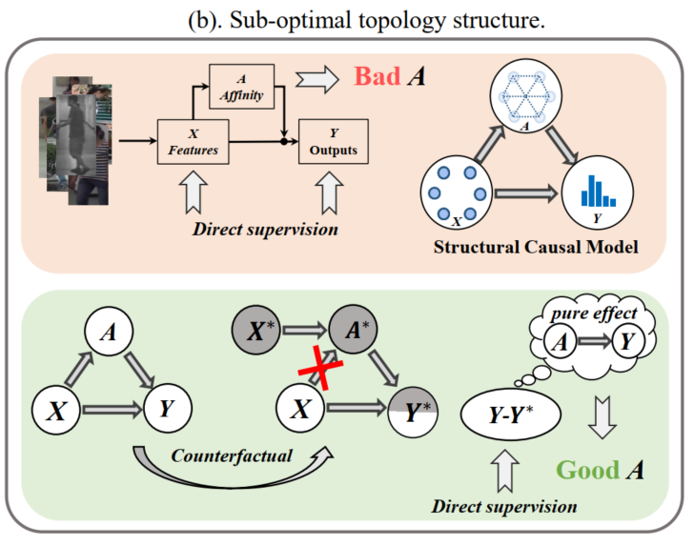
Sub-optimal topology structure
Sub-optimal topology structure caused by the end-to-end learning manner to the graph model. We analyze that the joint learning of backbone features and graph outputs weaken the learning of graph topology, making it not generalized enough during the inference process.
Our method uses a casual inference tool to calculate the pure effect contributed by the affinity changes only, making the model perceive the role of graph topology more direly.

Slide 9
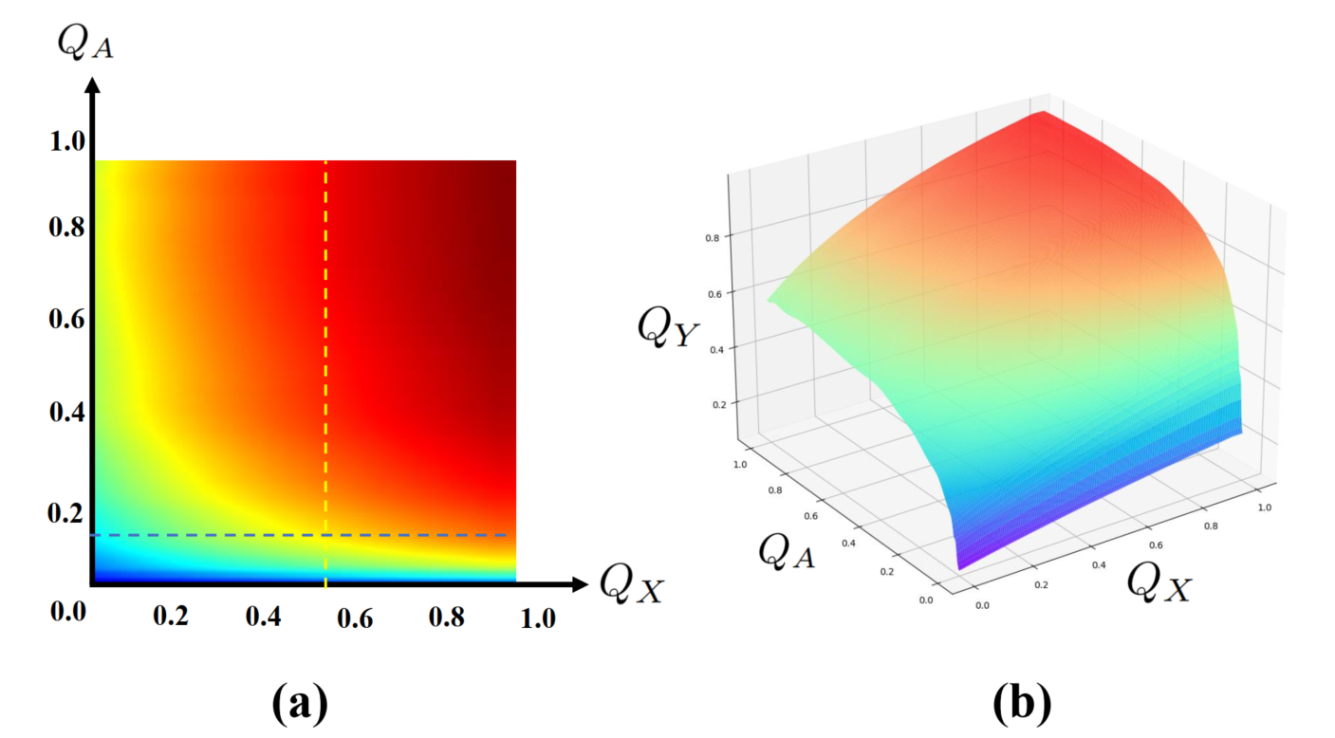
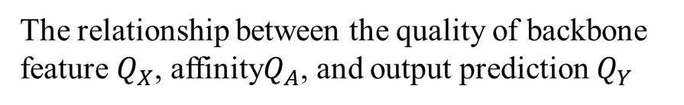
Sub-optimal topology structure
The relationship between the quality of backbone
feature $Q_{X}$, affinity$Q_{A}$, and output prediction $Q_{Y}$
We do some toy example experiments to see how do the X and A affect Y, which demonstrates this phenomenon that well-trained X and Y can lead to a flexible range of A, bringing sub-optimal topology structure.

Slide 10
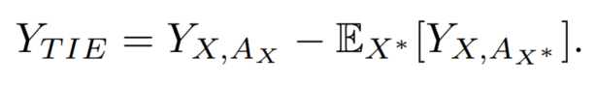
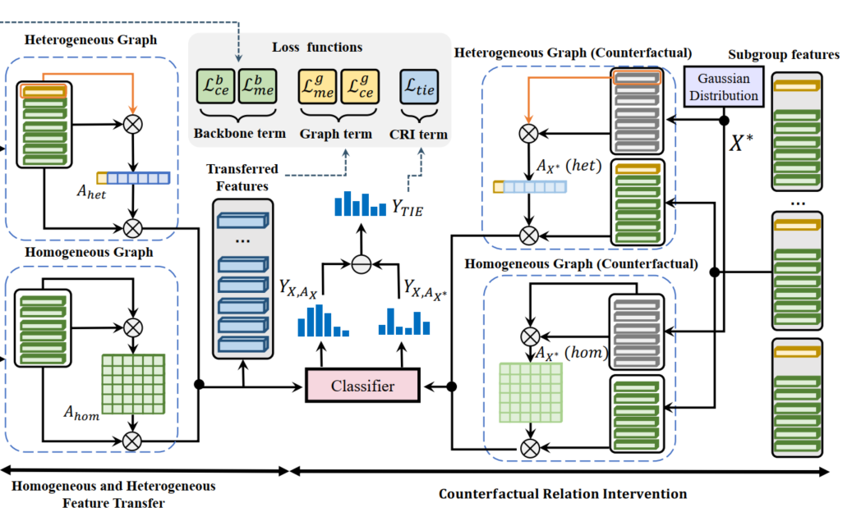
Counterfactual Relation Intervention
To tackle the Sub-optimal topology structure problem, we propose a new learning methods called Counterfactual Relation Intervention (CRI).
To highlight the A in the whole training process, we utilize the Total Indirect Effect (TIE). It is equal to keep all potential variables fixed but only change the affinity A, which can show the pure effect introduced by A.
Maximizing TIE is essentially equal to maximize the difference between the original output and a counterfactual output contributed by the affinity changes only, which can make the model perceive the function of the graph affinity without being affected by well-trained input features.

Slide 11
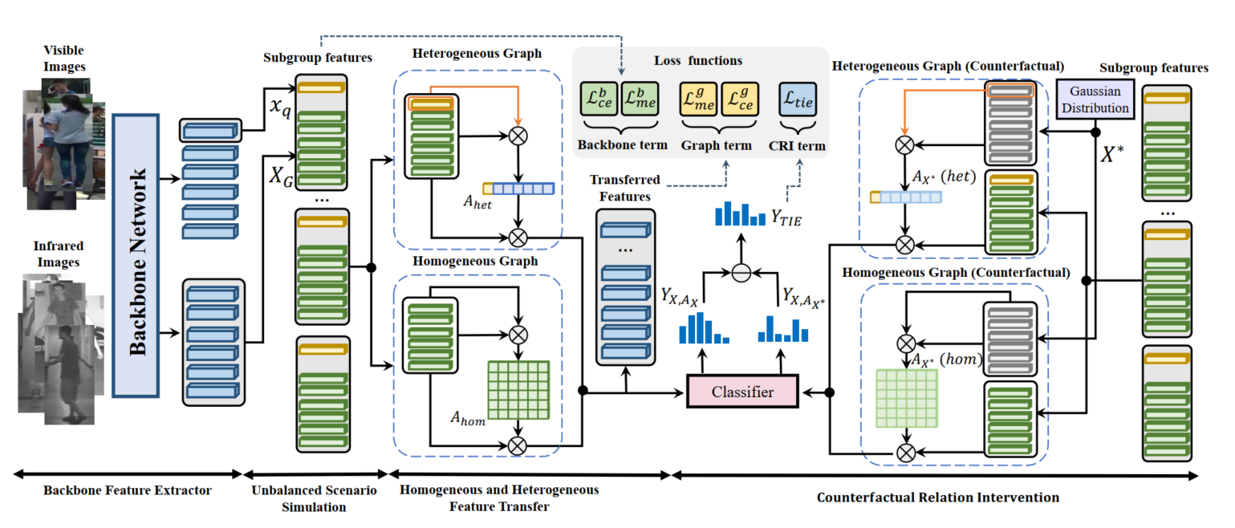
Overall Framework Design

Slide 12
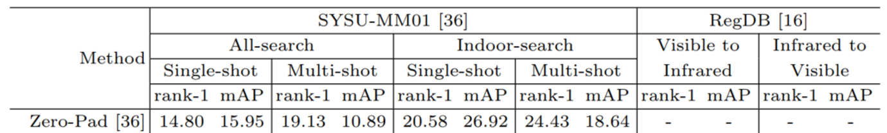
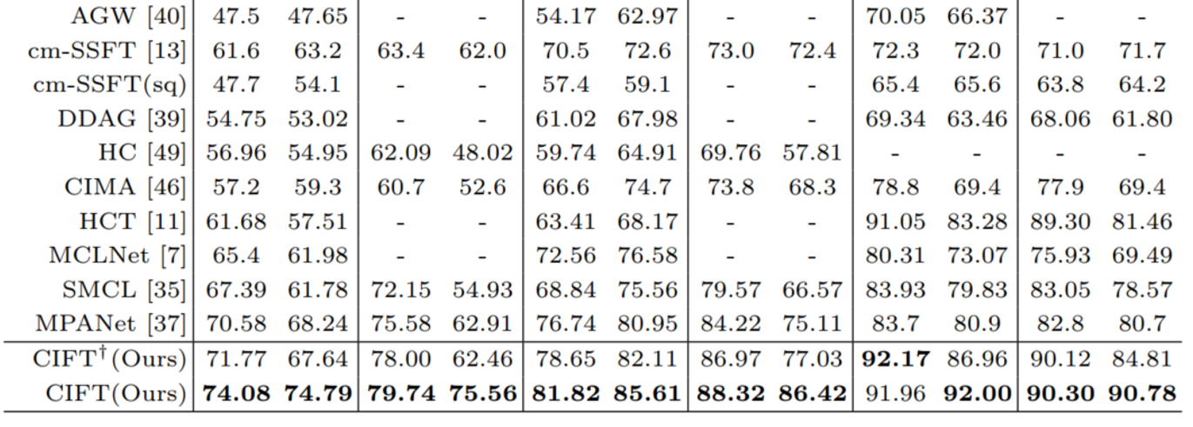
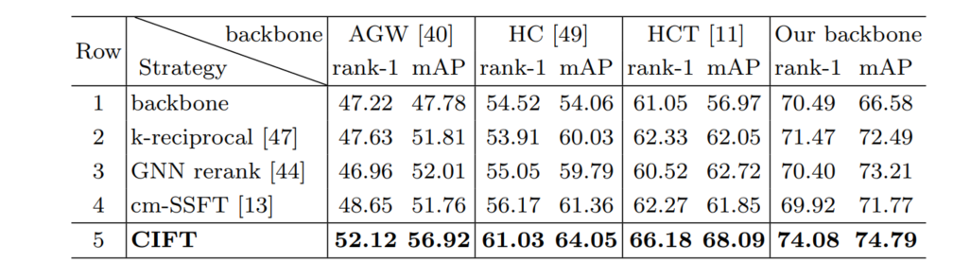
Experiments
The proposed method outperforms the existing SOTAs on both datasets.
To demonstrate the superiority of our method to other graph and post-process VI-ReID methods, we also compare it with other multi-gallery matching methods.

Slide 13
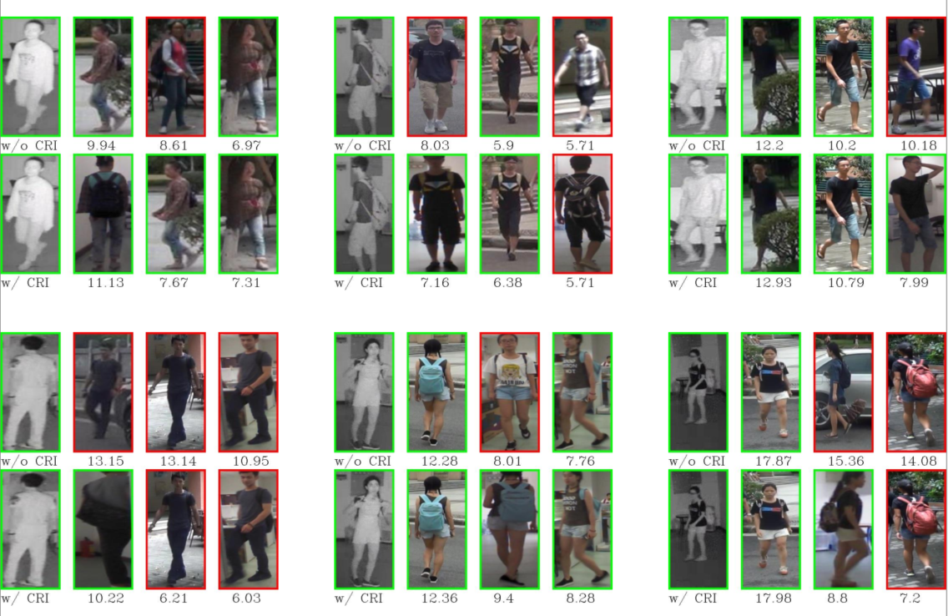
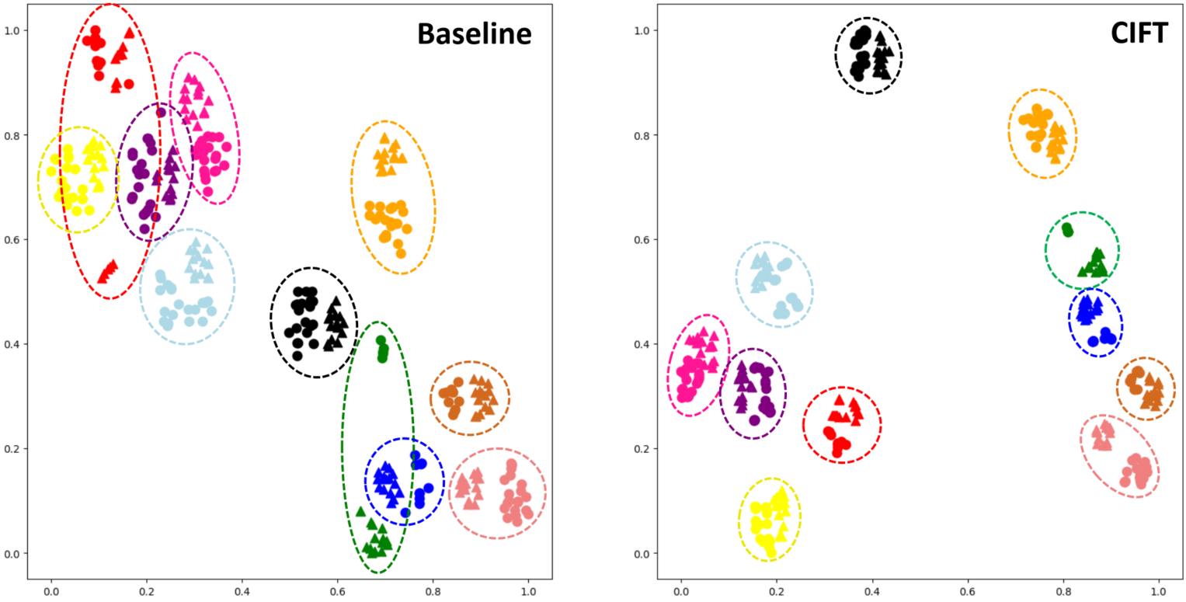
Visualization
Here we shows some visualization results, including t-SNE results and the visualizations of affinities value with and without CRI.

Slide 14
Conclusion
We delve into the existing VI-ReID graph model and find two main reasons for their low generalization.
We introduce a Homogeneous and Heterogeneous Feature Transfer including two independent types of well-designed graph module and an unbalanced scenario simulation.
We propose a Counterfactual Relation Intervention algorithm, which utilizes causal effect tools to highlight the role of the topology in the feature transfer module.

